Slide 1

L3Harris Capstone
Post-Quantum Cryptography
Instructor: Pauline Wade
TA: Brady Testa
Mentors: Jesse Hughes & Dwight Horne

Slide 2
Team Intro

Slide 3

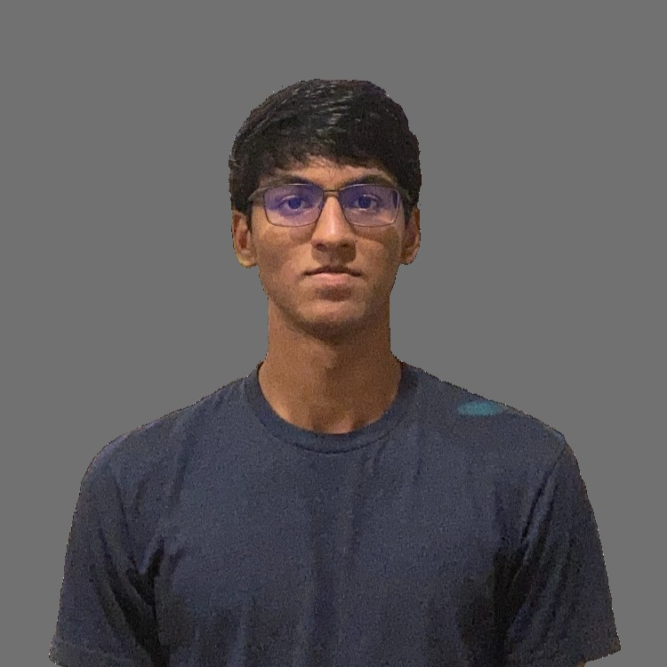

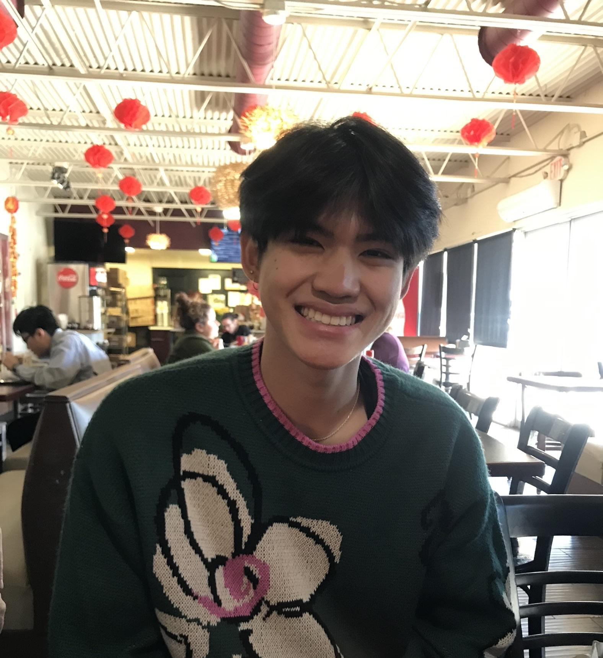

Aidan Heffron
Quality Assurance
Josef Munduchirakal
Schedule Manager
Shifan Hirani
Scope Coordinator
Blake Lun
Stakeholder Manager
Grant Shields
Risk Manager

Slide 4
Presentation Roadmap
Implementation
03
Intro + Motivation
01
How did we implement the solution?
What is this Project?
Evaluation
04
Requirements & Design
02
How did we evaluate our solution?
What was our scope & how did we design our solution?
Wrap-up
05

Slide 5
Introduction &
Motivation
Notes:
Ill lead us through the introduction here

Slide 6
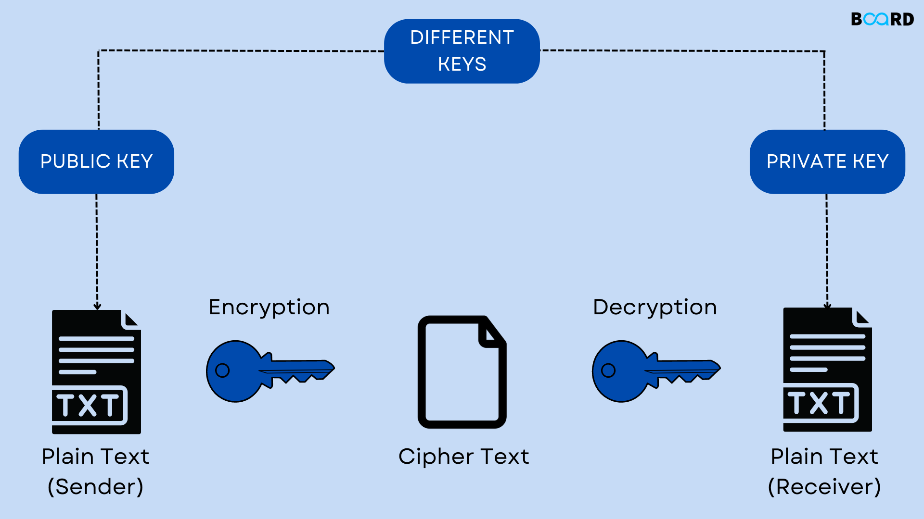
What is Cryptography?
Cryptography is the practice of creating and using secure communication between two or more entities.
Cryptography ensures:
Confidentiality
Protect data from unauthorized access
Integrity
Keep data unchanged during transmission or storage
Authenticity
Verifies the identity of the sender or recipient
Notes:
When visualizing data across a network, you can picture passing a note in a classroom where everyone sees what you wrote. Keeping a secret in this process is the core motivation of cryptography. Ideally, you would write a message such that only you and your final recipient can understand it. This process is called encryption.

Slide 7
Terms to Know
Classical Cryptography: modern day cryptography that uses less secure algorithms to encrypt, decrypt, and authenticate data.
RSA, Elliptic Curve (EC), etc.
Post-Quantum Cryptography: Cryptography that implements algorithms designed to withstand attacks from quantum computers. Components are usually larger and more complex.
Dilithium, Kyber, etc.
Notes:
Almost all data sent on the internet is encrypted using a classical encryption scheme. In this context, classical refers to the computers we have available today. Quantum refers to quantum computers and Post-Quantum is about life after quantum computers are widely available.

Slide 8
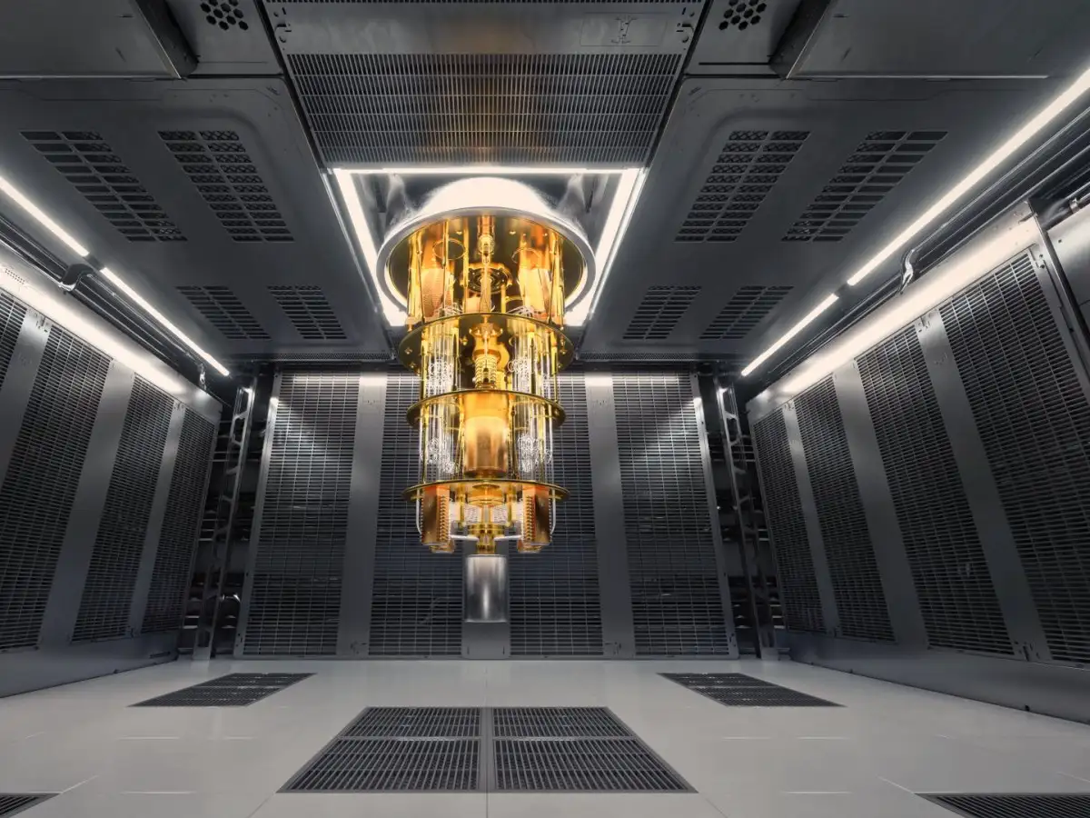
What’s the Issue?
With the rise of quantum computers, current encryption algorithms are more susceptible to being broken and exploited.
Sensitive data everywhere is at risk of being stolen
People don’t trust post-quantum cryptography on their networks yet
IBM’s 53-qubit quantum computer
Notes:
The issue at hand is that classical encryption algorithms work well for classical computers, but don’t stand a chance against even a single quantum computer. If these encryptions are broken, your data is vulnerable and the hands passing your note can read your messages!

Slide 9
Is this Novel? YES!
Our solution provides Go SDK functionality for creating and handling PQ X509 certificates, something that doesn’t exist
Our performance testing suite captures metrics for all parts of cryptography and can be used by consumers to verify results
Our network simulation testing provides invaluable data for network admins looking to transition into Post-Quantum cryptography
Notes:
Our solution is to swap the common classical encryption schemes for post-quantum schemes and keep networks secure.

Slide 10
Requirements &
Design

Slide 11
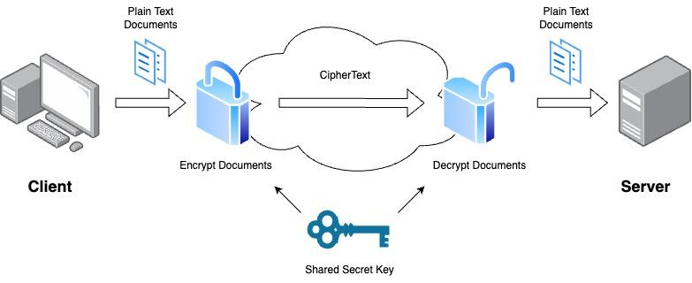
Acceptance Criteria
Our clients want a system that:
Uses post-quantum cryptography to create a secure tunnel between a client and a server
Has intuitive design and interface
Can capture performance metrics for a variety of algorithms
Comes with ample instructions for building and testing
Secure client/server tunnel Diagram

Slide 12
Requirements
Generate PQ Certificates
Verify PQ Certificates
Generate PQ Keys
Encrypt & Decrypt Messages
Performance Evaluation

Slide 13
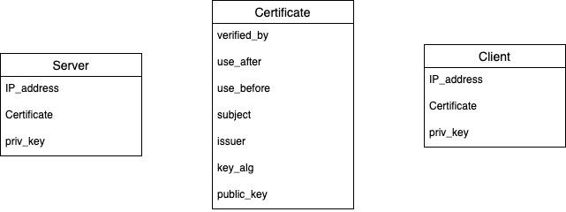
Data Design

Slide 14
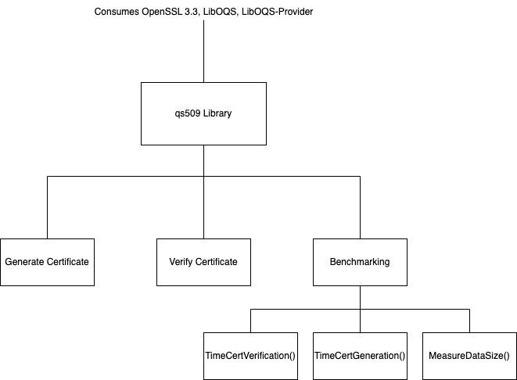
Structural Design - qs509
qs509 Library Structural Diagram

Slide 15
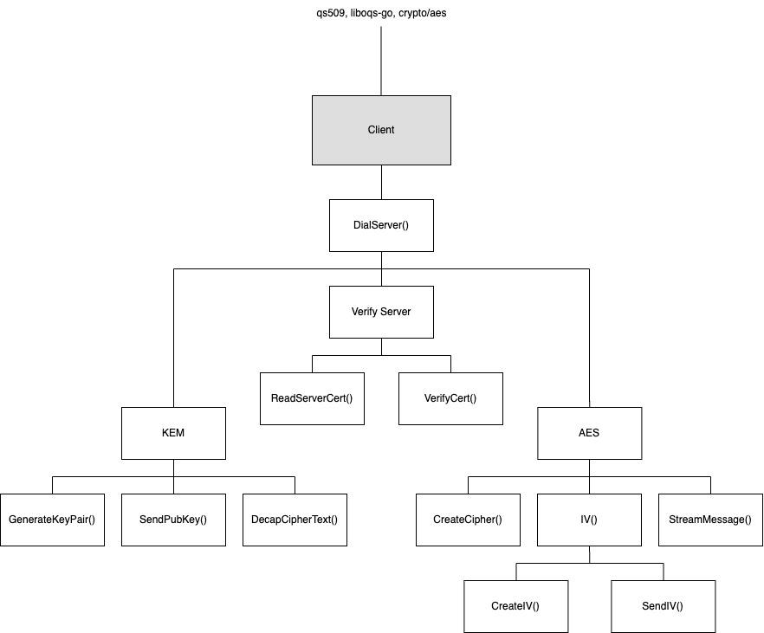
Structural Design - Client
Client Structural Diagram

Slide 16
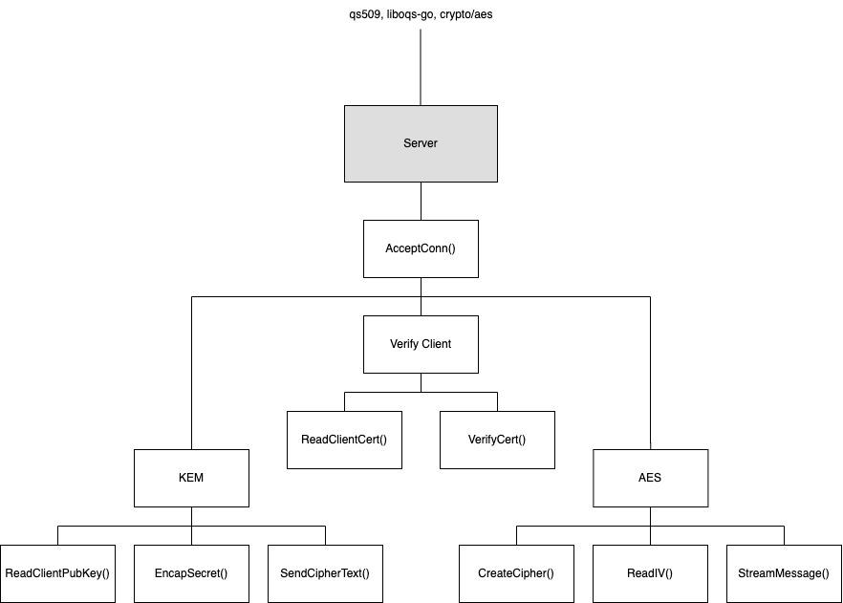
Structural Design - Server
Server Structural Diagram

Slide 17
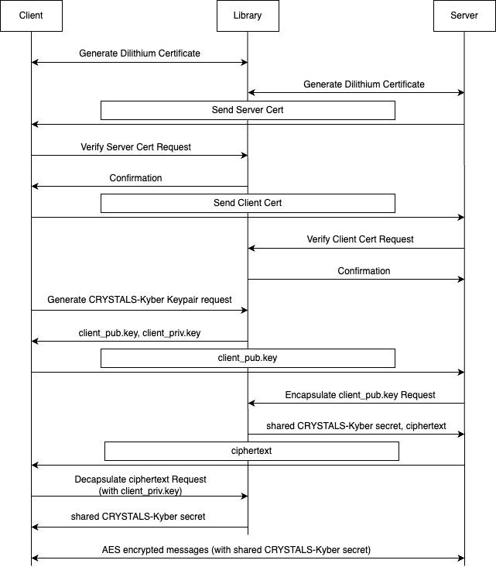
Dynamic Design (Sequence Diagram)

Slide 18
Implementation

Slide 19



Tech Stack

Slide 20
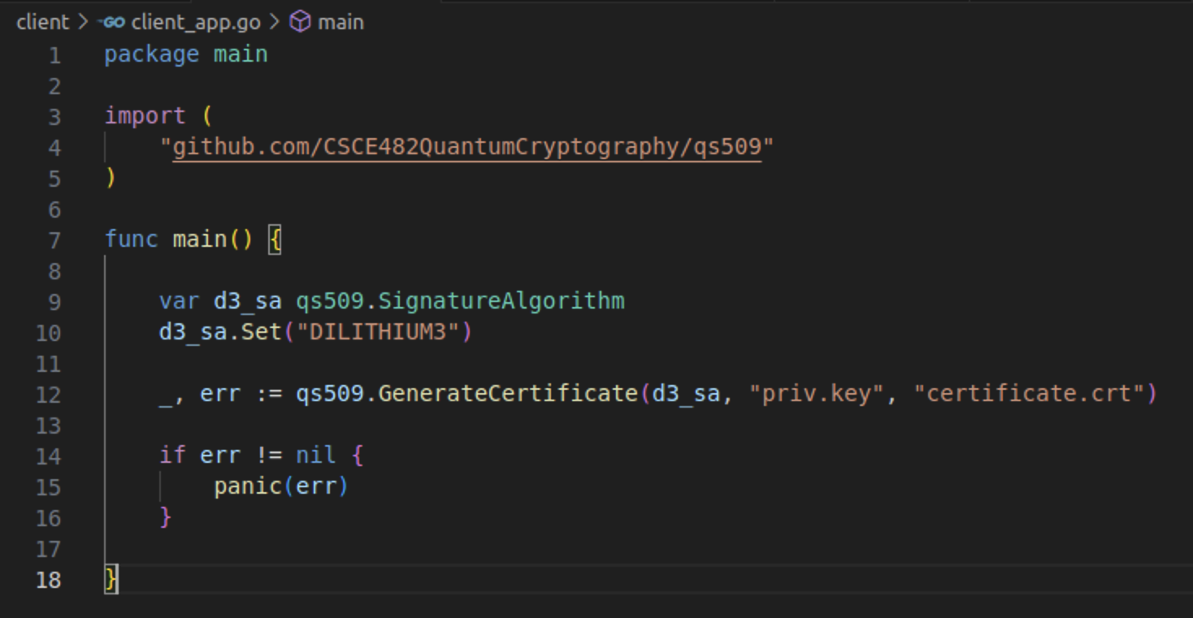
qs509 Library
We have created and exported a Go library that provides post-quantum certificate functionality
Example application using our library

Slide 21
Client / Server Application
To demonstrate our library, we have imported it into a custom client/server network application
Clients Dial the Server
Client and Server authenticate each other (certificates)
Client and Server agree on a secret key for encryption
Client and Server use the key to encrypt and decrypt messages

Slide 22
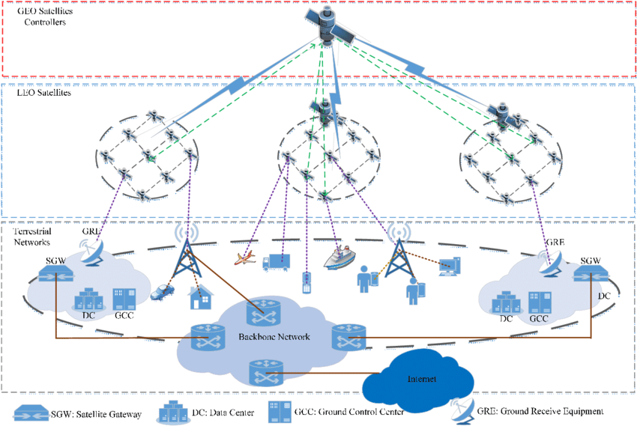
Mininet Simulations
With Mininet (a network simulator), we have created configurations that simulate many real-world network configurations.
NY to LA
NY to Tokyo
Low, Avg, High Bandwidth
Low, Avg, High Packet Loss
Low Earth Orbit Satellite
Geosynchronous Satellite
Different topologies we have implemented with mininet

Slide 23
Quick Demo

Slide 24
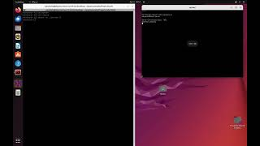

Slide 25
Evaluation

Slide 26
Quality Goals
Create a system that can be easily interacted with and has favorable feedback from at least 95% of users by the end of April
Create an architecture that allows clients to communicate with a server via 100% quantum encrypted and authenticated communication by April
Capture meaningful performance metrics during every portion of cryptography, tunneling, and authentication to give us a benchmark on how our system compares to classical implementations by April

Slide 27
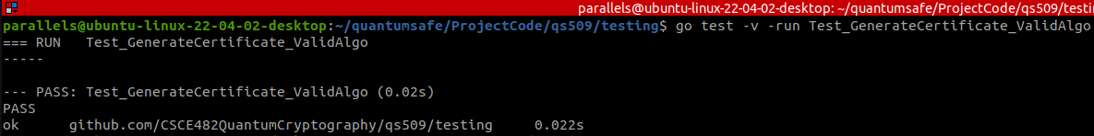
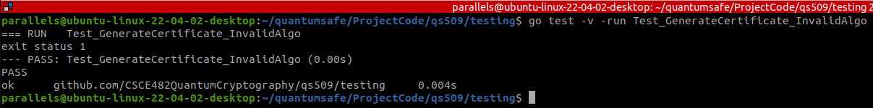
Unit Testing
Every single function in our code needs to be tested for Sunny day and Rainy Day cases
Sunny Day Test Case
Rainy Day Test Case

Slide 28
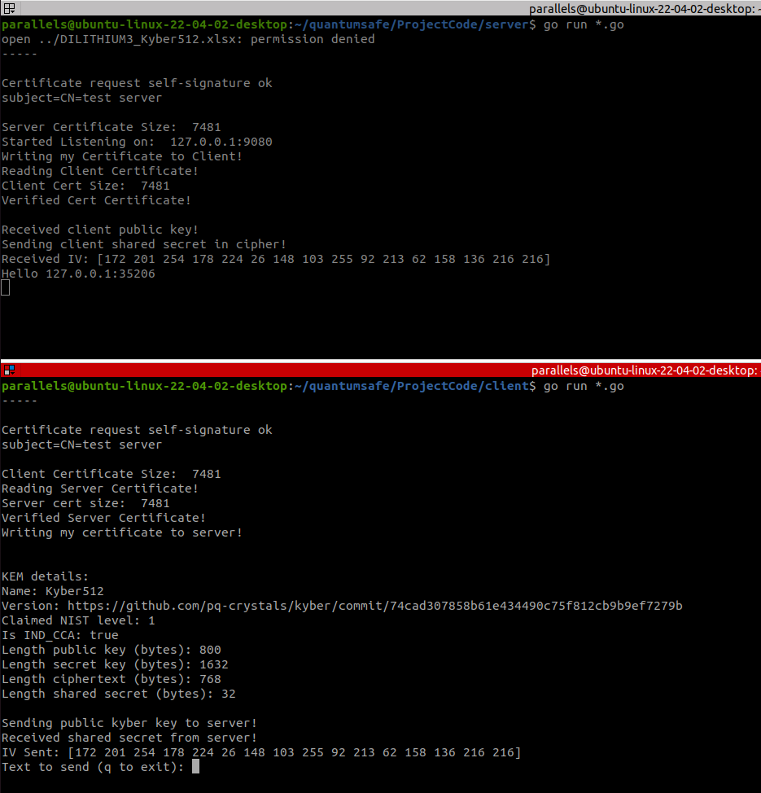
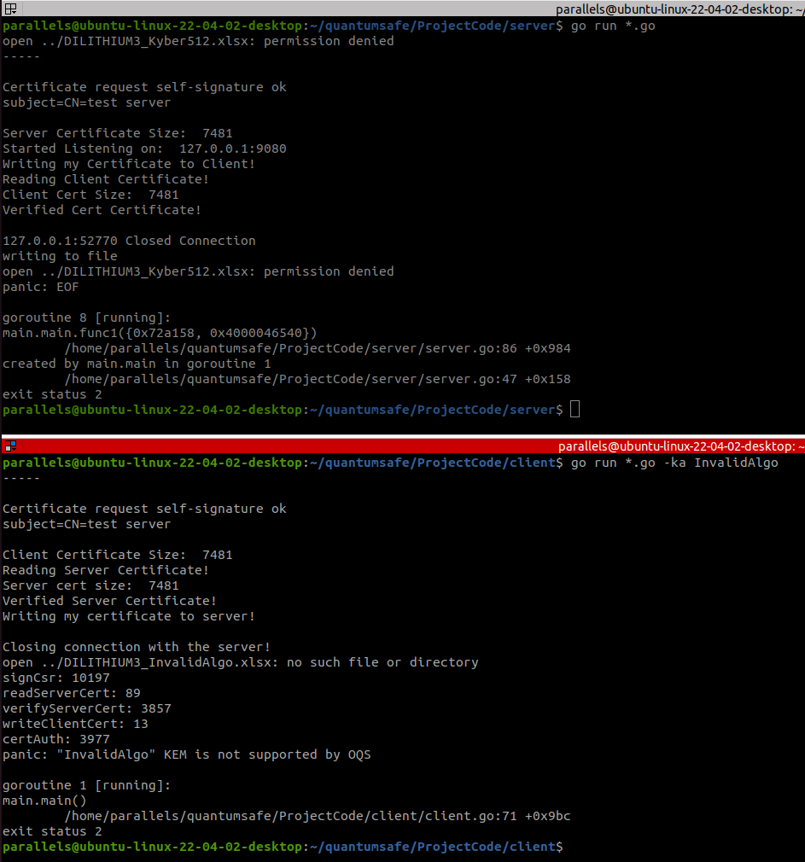
Integration Testing
Sunny Day Integration Test
Rainy Day Integration Test

Slide 29
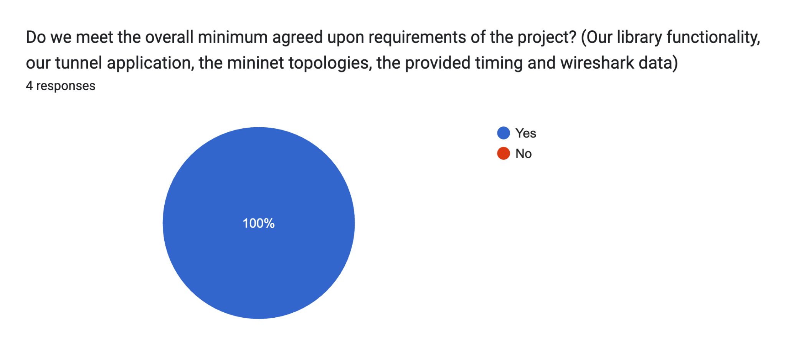
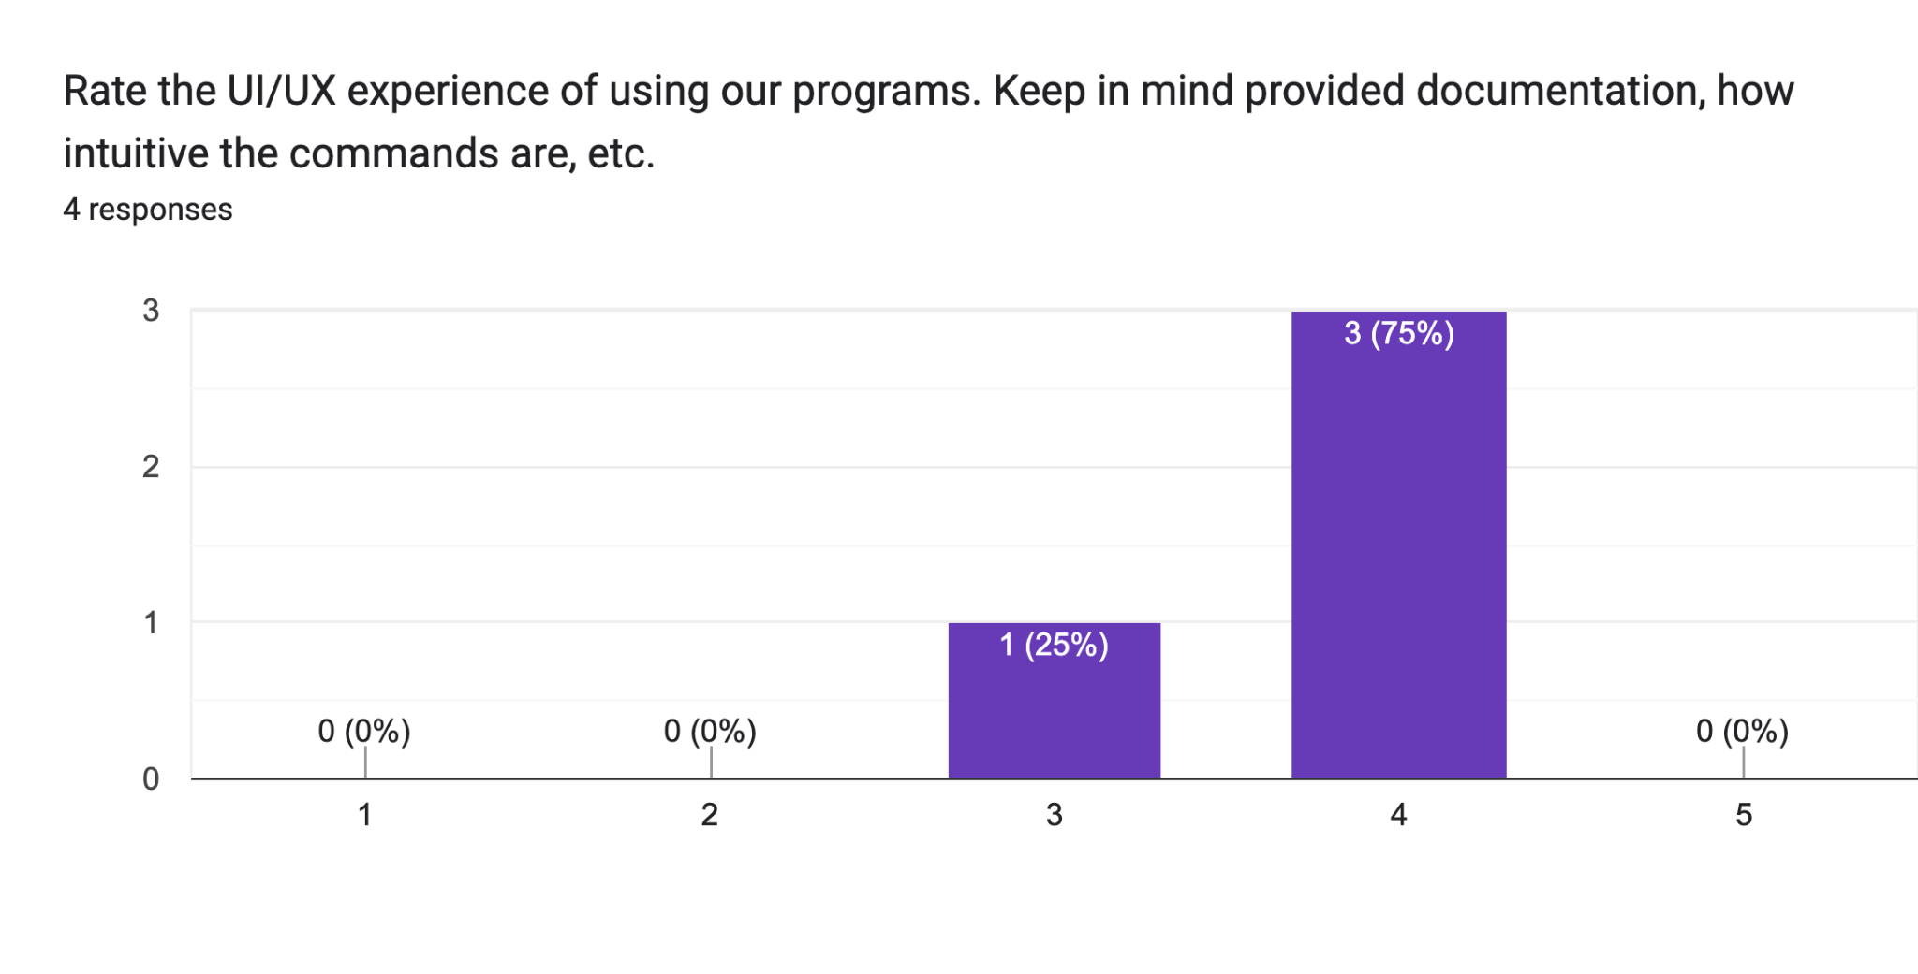
User Acceptance Testing
To fully test our program, we put it in the hands of our sponsor to collect feedback.
Our sponsors were given a Docker container with everything set up
They were given a questionnaire to fill out as they ran through various test cases

Slide 30
Ethical Concerns
The project must adhere to ethical standards, especially in the development and deployment of advanced cryptographic solutions
Environmental
Health/Safety
Increased data size can lead to increased energy consumption
Private data needs to be kept private. Cryptography should be a safe from any attacker.
Social
Political
Keeping our system fair, global, and secure. We want to develop trust.
Ensure technology is not empowering for some groups at the expense of others

Slide 31
Manufacturability and Sustainability Concerns
Manufacturability
Sustainability
Solutions developed are easily replicable and adaptable, enhancing manufacturability
Use of widely available technologies can facilitate the deployment and scaling of solution
Long-lasting and effective against future threats
Use of PQC aims to future-proof cybersecurity measures against emerging quantum computing threats

Slide 32

Project Management - Budget
Our project does not require a budget. All software is open-source
Given the project scope and the potential for commercial application, a company could expect to spend upwards of $105,000 to $130,000 for a fully implemented system.
Based off considerations like: licensing, manpower for development and implementation, and extensive testing.

Slide 33
Our Results

Slide 34
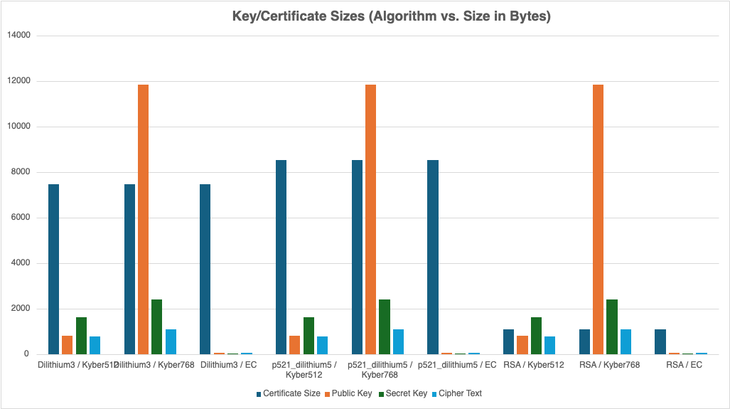
Component Sizing
Purely classical components are much smaller than post-quantum

Slide 35
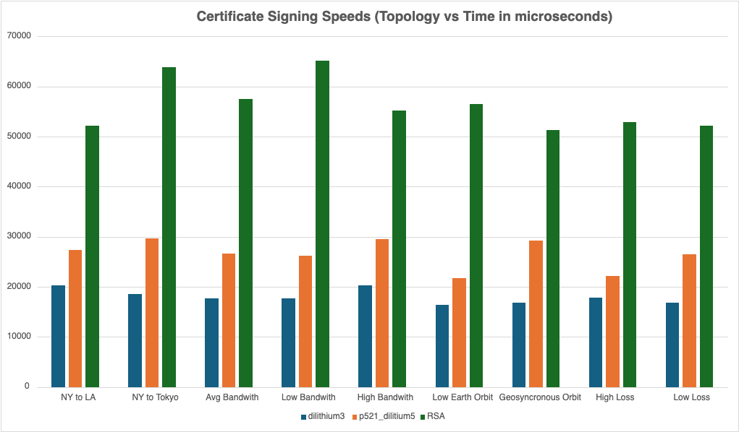
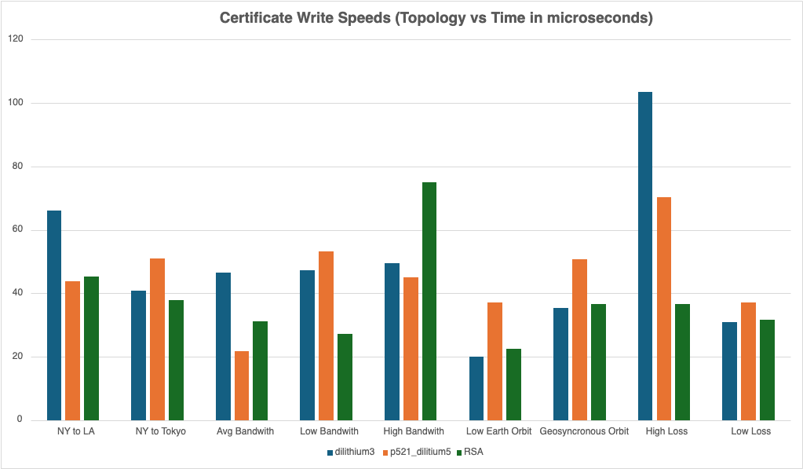
How does Data Size Effect Certificates?
Despite being smaller, RSA certificates tend to take longer to produce than Dilithium certificates.
However, RSA certificates still tend to be sent between hosts much faster.

Slide 36
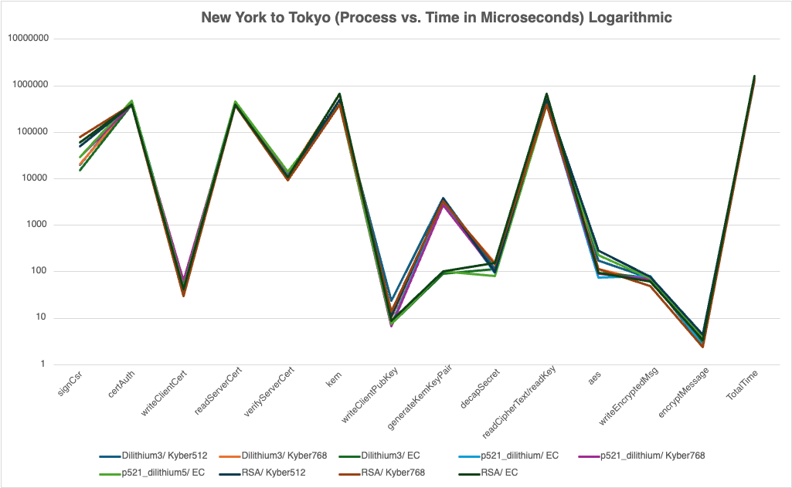
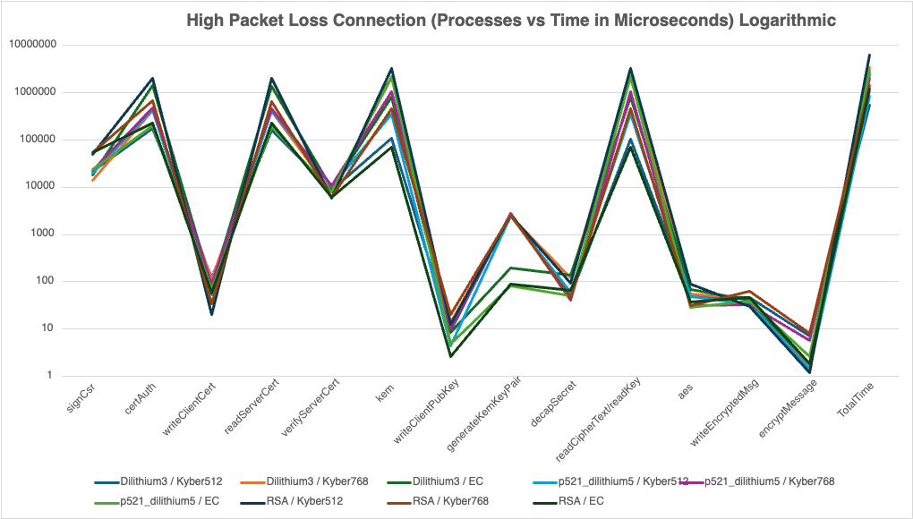
Is Post-Quantum Cryptography Viable?
Classical cryptography starts to perform much better
For most networks, yes.
The effects of having larger cryptographic components is mainly only felt in networks with large amounts of loss or very limited bandwidth. In a typical connection, the increased size is not noticeable enough.
Results from NY to TO Network
Results from High Packet Loss Network

Slide 37
Wrap-Up

Slide 38
Discussion
Methodology
By splitting into internal teams, our group was able to specialize in different areas and complete tasks faster
Project Management
Everyone was given a specific role which allowed us to ensure we were meeting deadlines and producing quality work
Ethics
Cryptography is a very controversial ethics topic. Given the possible misuse of our system, should we build a backdoor?

Slide 39
Future Work
To continue this project, developers could look into:
Adding qs509 wrappers for other languages
Providing more network topology simulations
Implementing qs509 in existing network architectures
OpenZiti

Slide 40
Parting Thoughts
Our library enables post-quantum cryptography for any Go application
Our performance data can be used by network admins to understand the effect of post-quantum cryptography on their systems

Slide 41
Thanks and Gig ‘em!
Any Questions?

